Slide 1
While Loop based Programming
WAJP to print sum of all natural numbers from 1 to 100.
1+2+3+4+………+100
Q1

Slide 2
While Loop based Programming
WAJP to print sum of all even numbers from 1 to 100.
2+4+6+8+………upto 100
Q2

Slide 3
While Loop based Programming
WAJP to print sum of all Odd numbers from 1 to 100.
1+3+5+7+………upto 100
Q3

Slide 4
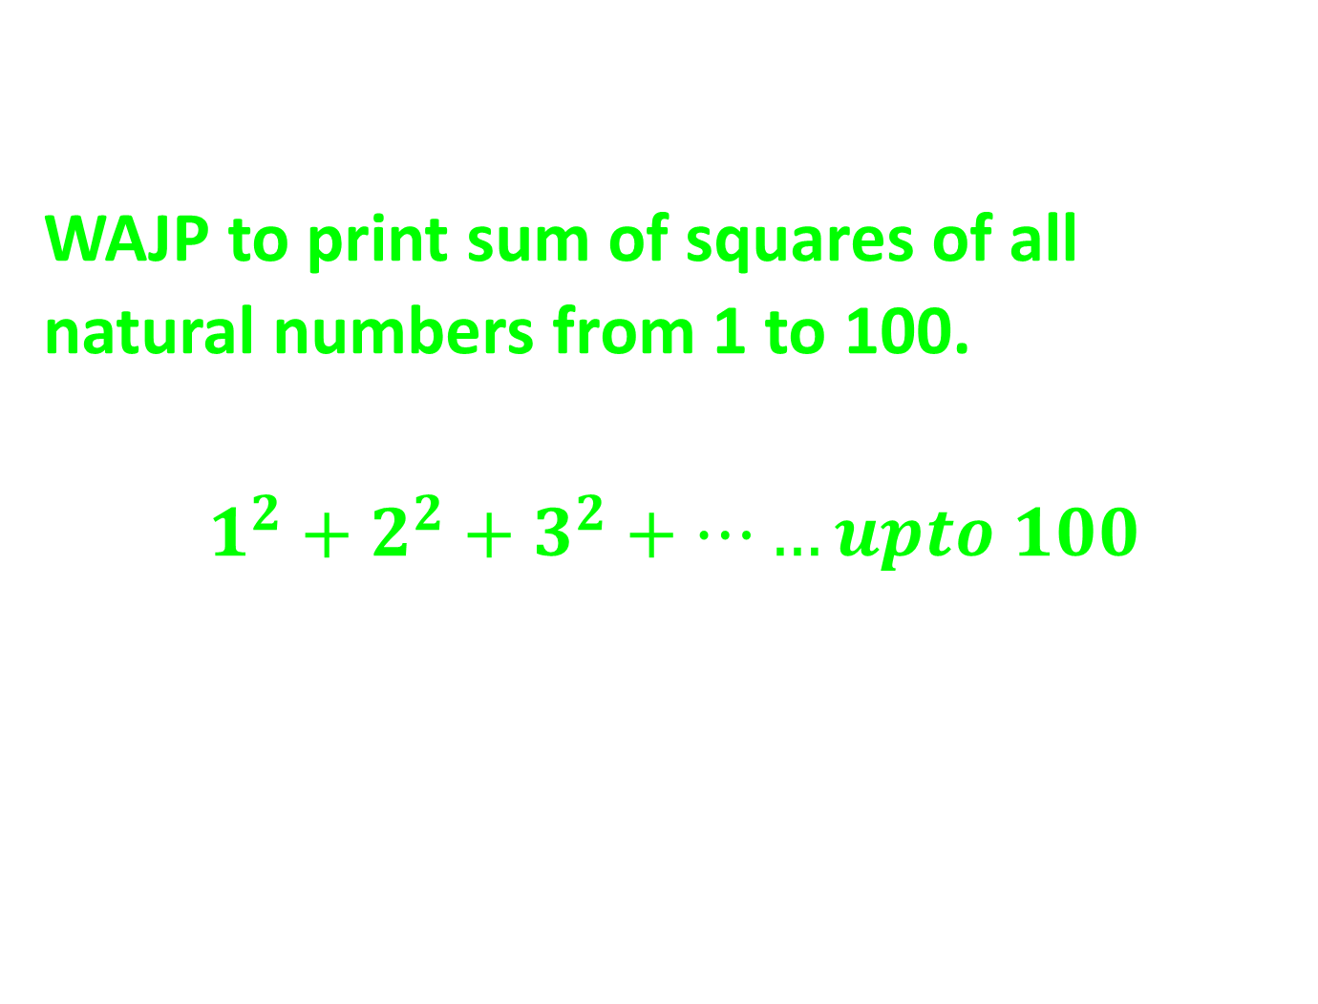
While Loop based Programming
WAJP to print sum of squares of all natural numbers from 1 to 100.
$$1^{2}+2^{2}+3^{2}+……upto 100$$
Q4

Slide 5
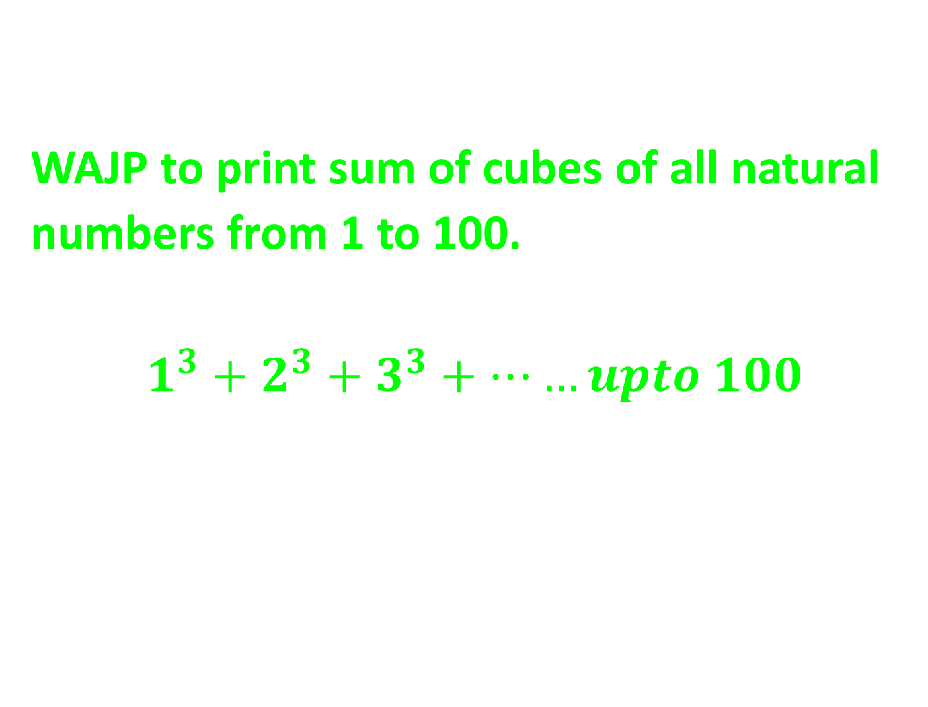
While Loop based Programming
WAJP to print sum of cubes of all natural numbers from 1 to 100.
$$1^{3}+2^{3}+3^{3}+……upto 100$$
Q5

Slide 6
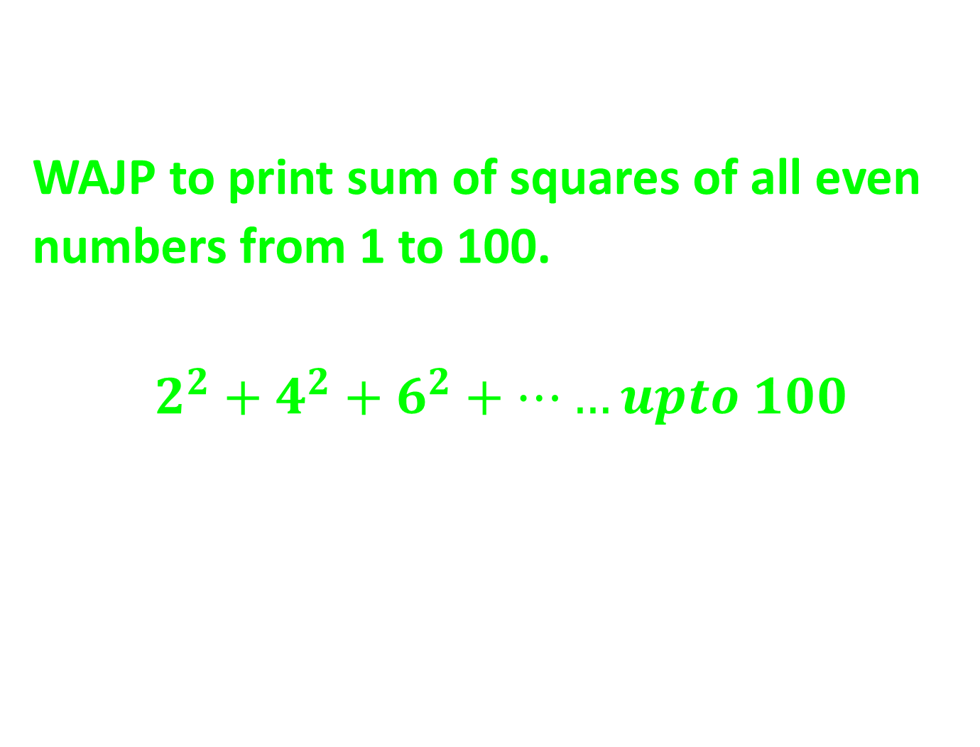
While Loop based Programming
WAJP to print sum of squares of all even numbers from 1 to 100.
$$2^{2}+4^{2}+6^{2}+……upto 100$$
Q6

Slide 7
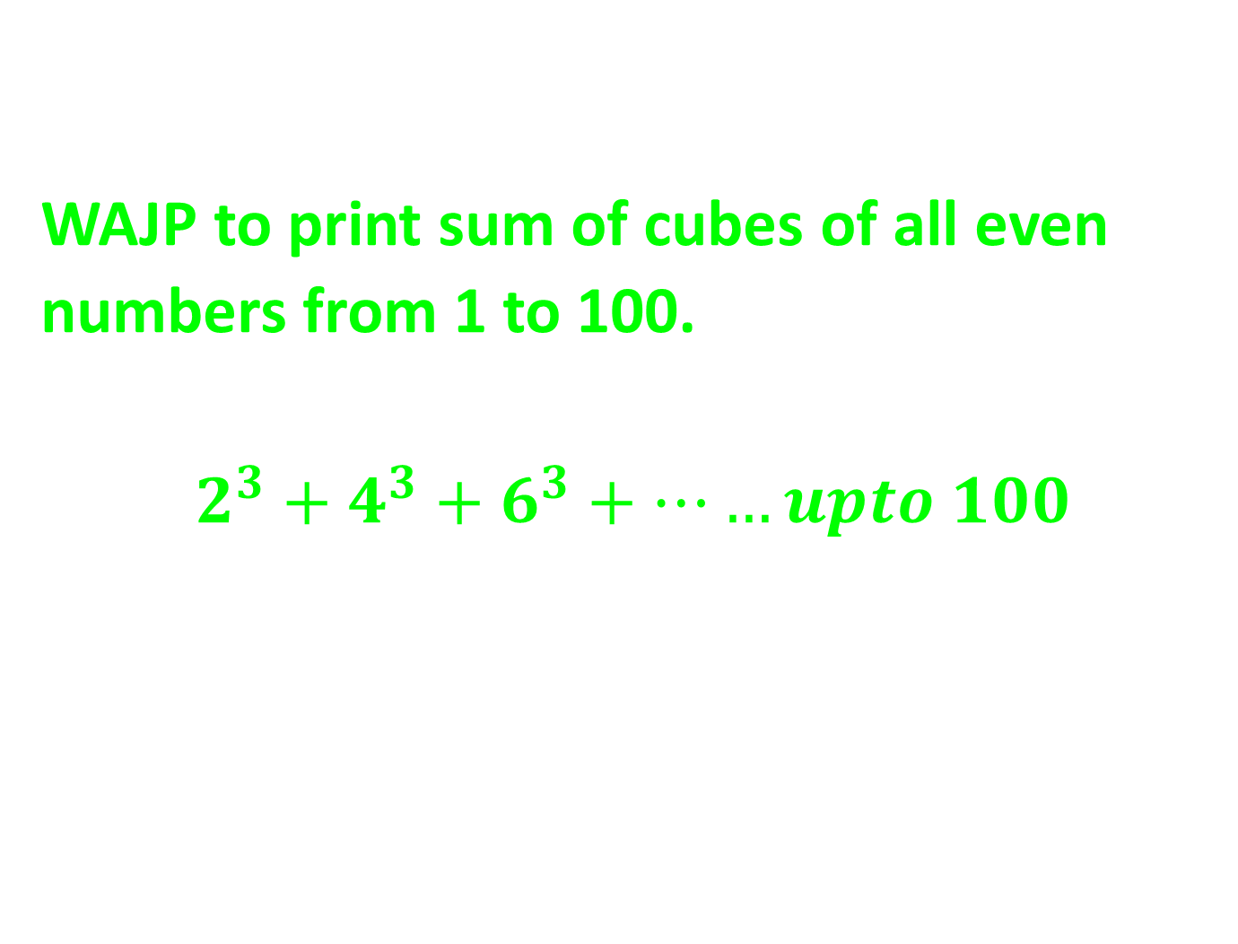
While Loop based Programming
WAJP to print sum of cubes of all even numbers from 1 to 100.
$$2^{3}+4^{3}+6^{3}+……upto 100$$
Q7

Slide 8
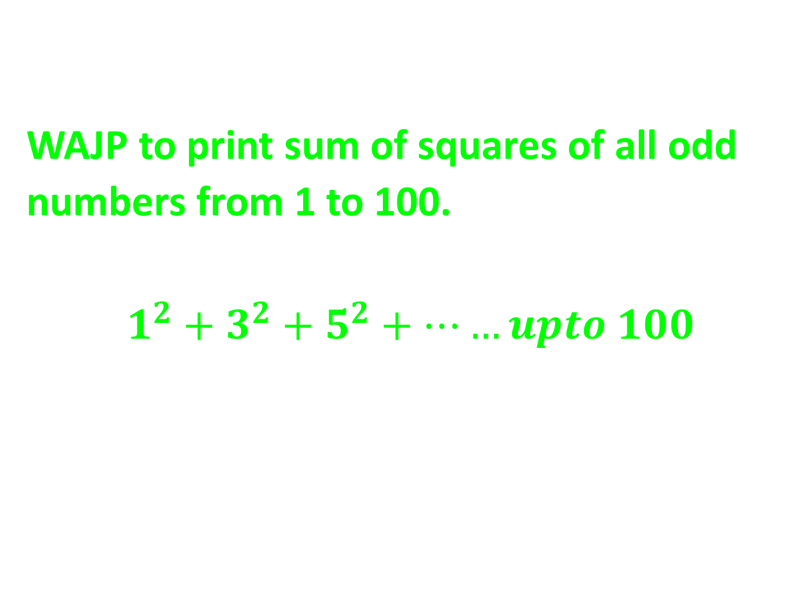
While Loop based Programming
WAJP to print sum of squares of all odd numbers from 1 to 100.
$$1^{2}+3^{2}+5^{2}+……upto 100$$
Q8

Slide 9
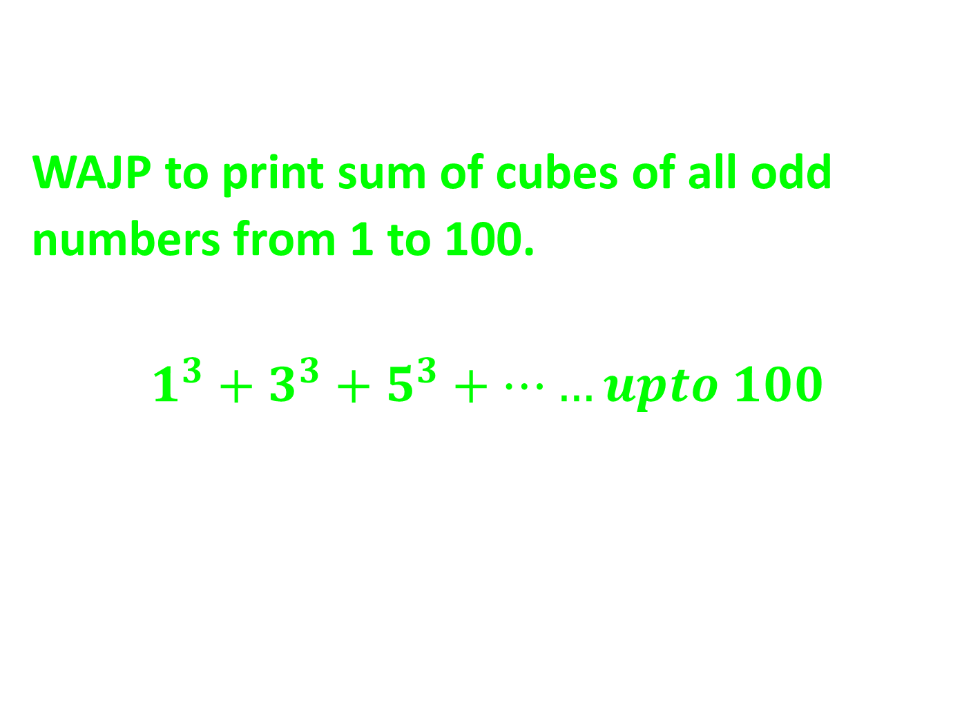
While Loop based Programming
WAJP to print sum of cubes of all odd numbers from 1 to 100.
$$1^{3}+3^{3}+5^{3}+……upto 100$$
Q9

Slide 10

While Loop based Programming
WAJP to print the sum of below series:
$$1∗2+2∗3+3∗4……upto 100$$
Q10

Slide 11

While Loop based Programming
WAJP to print the sum of below series:
$$1∗2^{2}+2∗3^{2}+3∗4^{2}……upto 100$$
Q11

Slide 12

While Loop based Programming
WAJP to print the sum of below series:
$$1^{2}∗2+2^{2}∗3+3^{2}∗4……upto 100$$
Q12

Slide 13
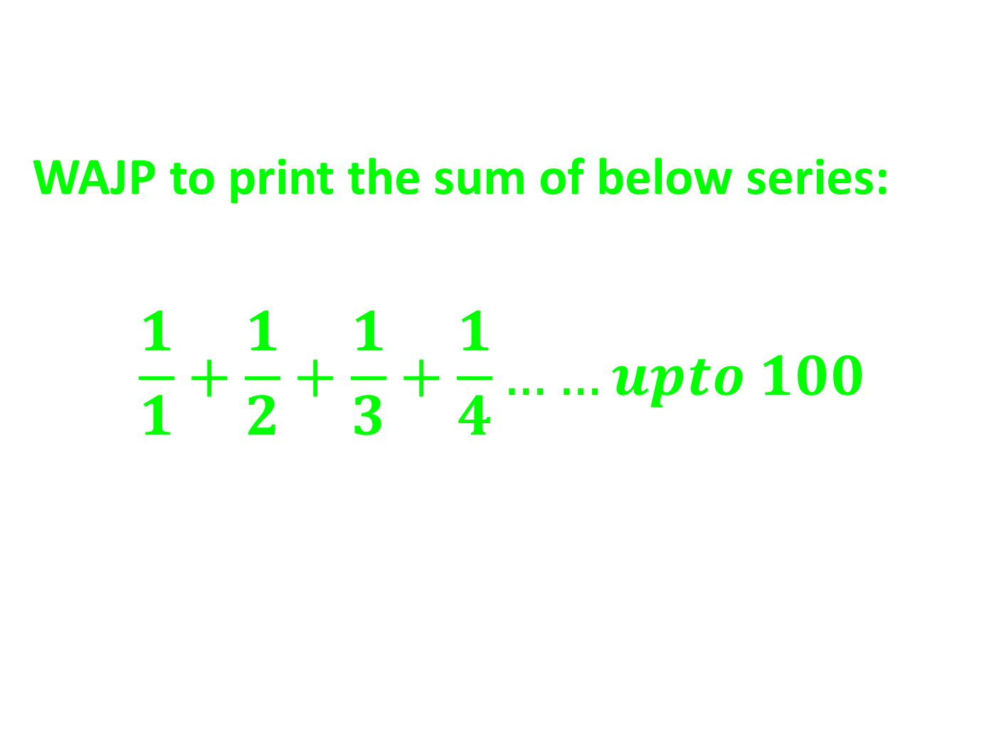
While Loop based Programming
WAJP to print the sum of below series:
$$\frac{1}{1}+\frac{1}{2}+\frac{1}{3}+\frac{1}{4}……upto 100$$
Q13

Slide 14
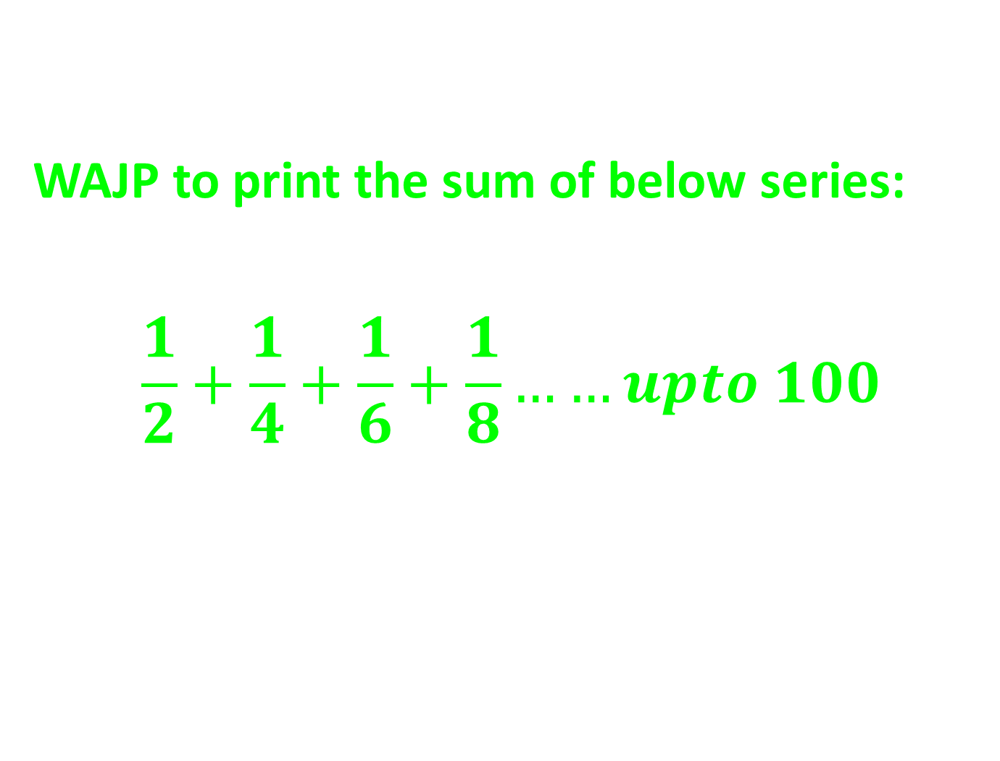
While Loop based Programming
WAJP to print the sum of below series:
$$\frac{1}{2}+\frac{1}{4}+\frac{1}{6}+\frac{1}{8}……upto 100$$
Q14

Slide 15

While Loop based Programming
WAJP to print the sum of below series:
$$\frac{1}{1}+\frac{1}{3}+\frac{1}{5}+\frac{1}{7}……upto 100$$
Q15

Slide 16
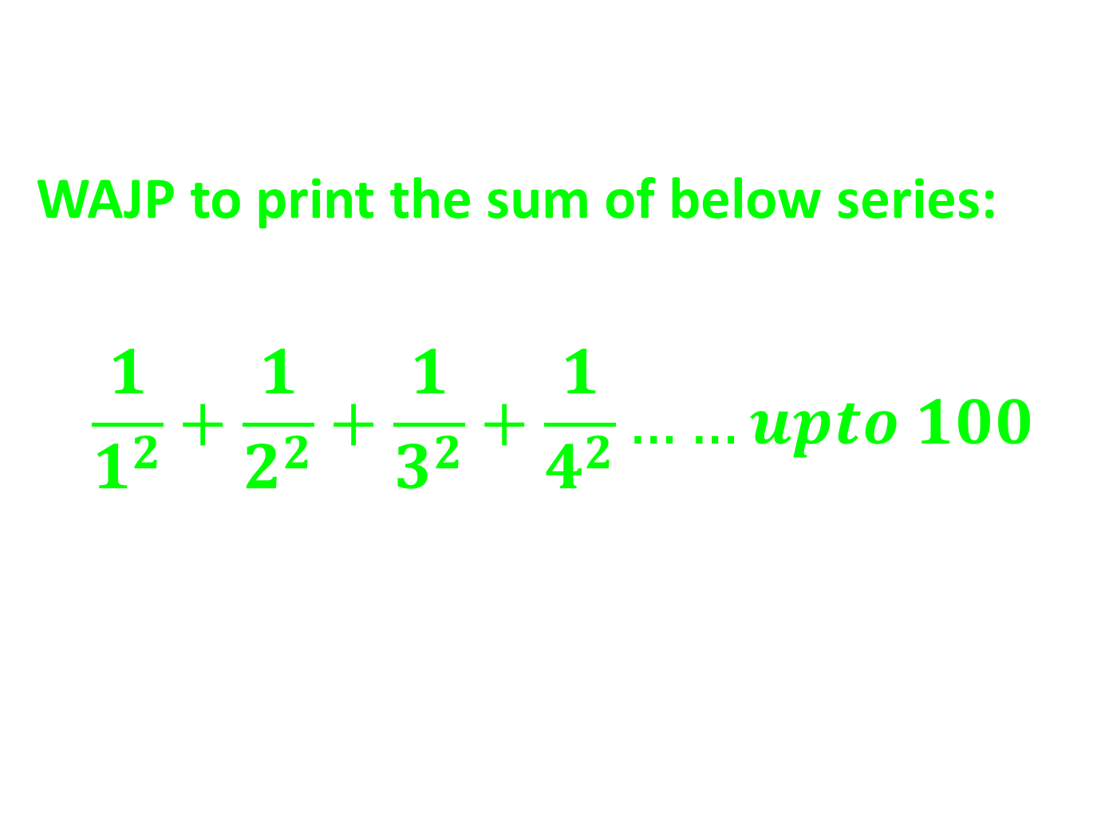
While Loop based Programming
WAJP to print the sum of below series:
$$\frac{1}{1^{2}}+\frac{1}{2^{2}}+\frac{1}{3^{2}}+\frac{1}{4^{2}}……upto 100$$
Q16

Slide 17

While Loop based Programming
WAJP to print the sum of below series:
$$\frac{1}{1^{3}}+\frac{1}{2^{3}}+\frac{1}{3^{3}}+\frac{1}{4^{3}}……upto 100$$
Q17

Slide 18

While Loop based Programming
WAJP to print the sum of below series:
$$\frac{1}{1∗2}+\frac{1}{2∗3}+\frac{1}{3∗4}+\frac{1}{4∗5}……upto 100$$
Q18

Slide 19
While Loop based Programming
WAJP to accept a input from user and print factorial of that number.
i/p: 6
o/p: 6!= 720
Q19
Important
Don’t leave it..!!

Slide 20
While Loop based Programming
WAJP to accept two numbers from user and print power of a to b.
i/p: 6 3
o/p: 6 to power 3 is: 216
Q20
Important
Don’t leave it..!!

Slide 21
While Loop based Programming
WAJP to accept a number from user and print sum of all its factors(number itself excluded).
i/p: 14
o/p: sum is: 10 (1+2+7)
Q21
Important
Don’t leave it..!!

Slide 22
While Loop based Programming
WAJP to accept a number from user and print the number is a perfect number or not.
i/p: 28
o/p: 28 is a perfect number
Perfect number: if the sum of all factors of a
Number is equals to number itself then
It is a perfect number.
Q22
Important
Don’t leave it..!!

Slide 23
While Loop based Programming
Perfect Number:
https://leetcode.com/problems/perfect-number/description/
Q23
Important
Don’t leave it..!!

Slide 24
While Loop based Programming
Three Divisors:
Three Divisors - LeetCode
Q24

Slide 25
While Loop based Programming
Common Factor:
https://leetcode.com/problems/number-of-common-factors/description/
Q25

Slide 26
While Loop based Programming
K-th Factor of n:
https://leetcode.com/problems/the-kth-factor-of-n/
Q26

Slide 27
While Loop based Programming
Smallest Even Multiple:
Smallest Even Multiple - LeetCode
Q27

